Slide 1

Social Trends - IncubateIND
Team Name: LAST KNIGHT CODERS
Team Leader: Shantanu Gupta
Team Member: Shantanu Gupta
Priya Saini

Slide 2

Description :
We build a website where anyone can see latest live trends of social sites by State-wise and country-wise.
We display analysis by graph and focus on UI/UX designing to attract visitors more and make easier to understand.
Possibilities to show and compare latest and trending #HASHTAGS.

Slide 3

Screen-Recording
Here some screen-Record of work which has been done till now.
Firstly We completed frontend page of our website.
Next Page

Slide 4
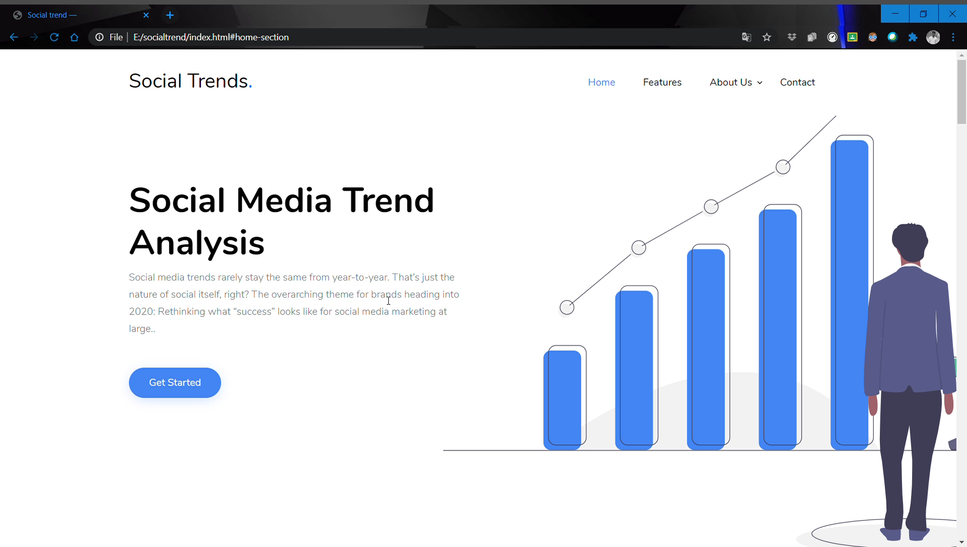

Slide 5

Technology Stacks:
Frontend / UI / UX:
HTML
CSS
JavaScript
bootsrap
Backend:
API
Machine Learning Algorithms(Time Series analysis, Regression)

Slide 6

Dependencies:
API Providers Admin Controller

